Slide 1
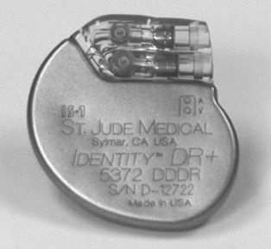
Basics of pacemaker part 1
Dr Suresh S
SR, MCH Calicut

Slide 2
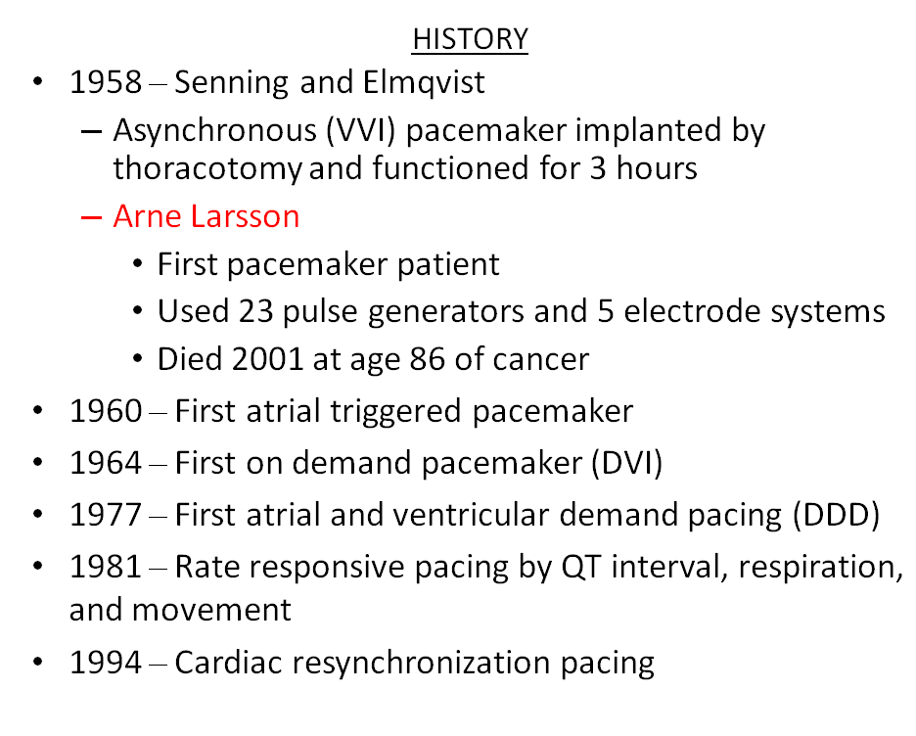

Slide 3
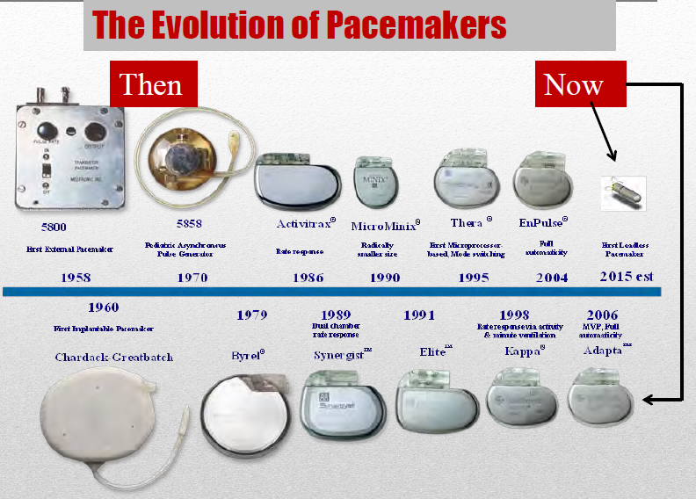

Slide 4
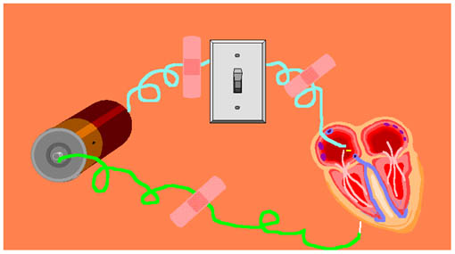
The Pacemaker System
Cardiac Pacing is the artificial electrical stimulation of the heart in the absence of intrinsic heartbeats causing it to contract

Slide 5
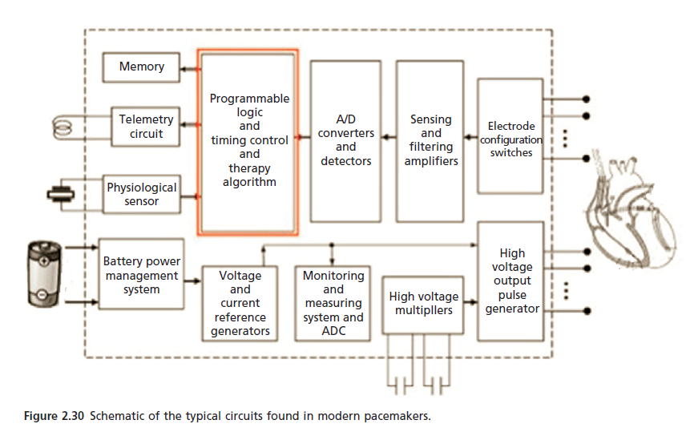

Slide 6
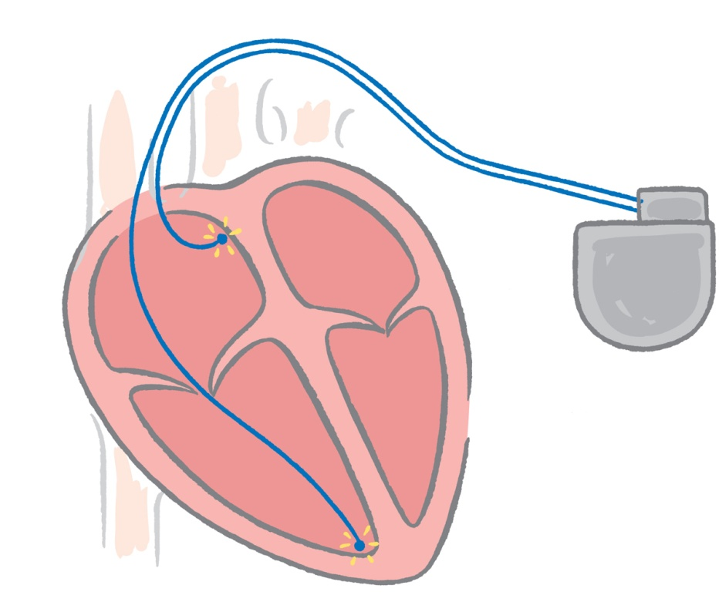
Implantable Pacemaker Circuit
Leads
Implantable pulse generator (IPG):
  Battery
  Circuitry
  Connector(s)
Leads or wires
  Cathode (negative electrode)
  Anode (positive electrode)
Body tissue
IPG
Anode
Cathode
Notes:
In a pacing system, body tissue is part of the circuit in the sense that it transmits the electrical impulse cell-to-cell (at the electrode-tissue interface). When the lead impedance is measured it includes this portion of the circuit as well.

Slide 7
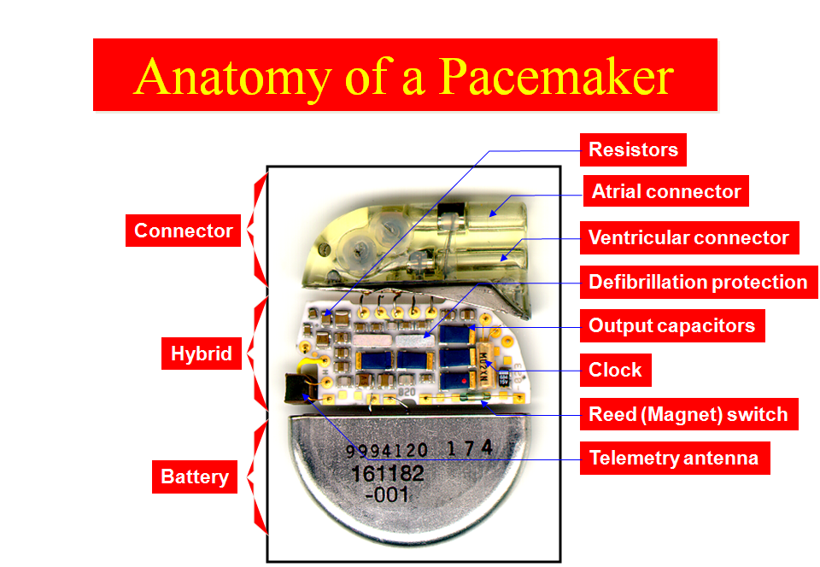

Slide 8
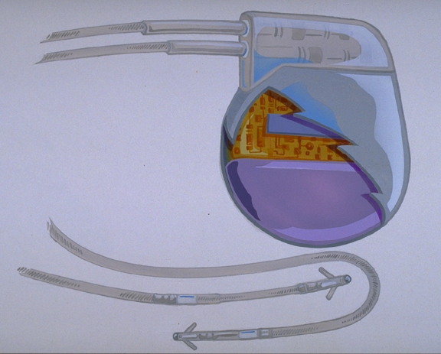
The Pulse Generator
Common battery compositions include:
  Lithium-Iodine
  Lithium silver vanadium oxide with carbon monoflouride
  Starting battery voltage will vary depending on composition
Longevity
  Dependent on impedance and output
  Commonly ranges from 6-12 years
Circuitry
Battery
Notes:
Lithium-iodine is the most commonly used power source for today’s pacemakers. Microprocessors (both ROM and RAM) control sensing, output, telemetry, and diagnostic circuits.

Slide 9
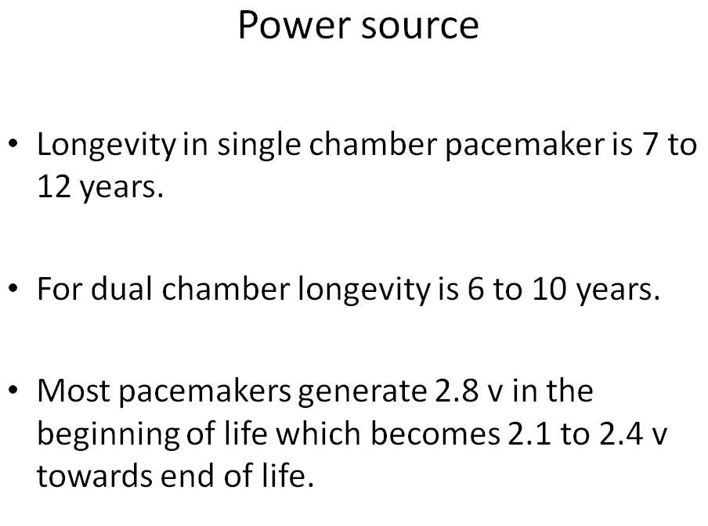

Slide 10
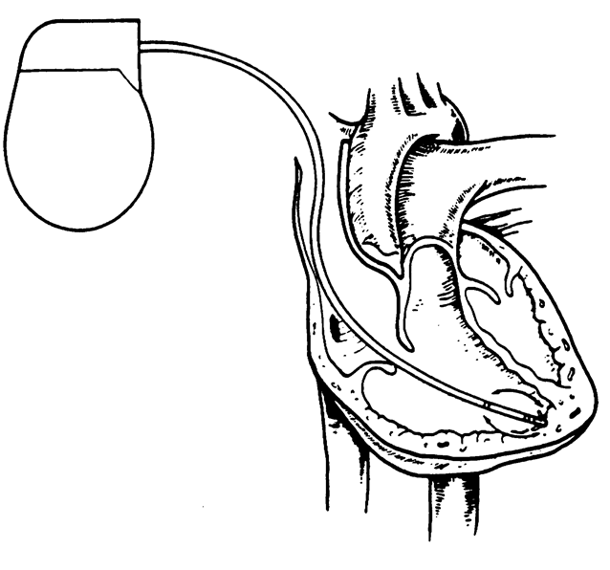
Leads are Insulated Wires
Deliver electrical impulses from the pulse generator to the heart
Sense cardiac depolarization
Lead
Notes:
The average heart beats about 35 million times in a year, and a pacemaker lead must be able to survive this harsh environment. The lead is subject to mechanical torque, flexing, bending, and the body’s natural defenses and bio-chemicals produced in response to inflammation. Pacemaker leads are designed to withstand these forces.

Slide 11
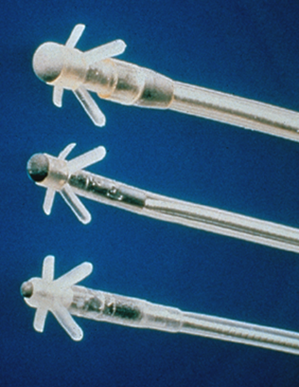
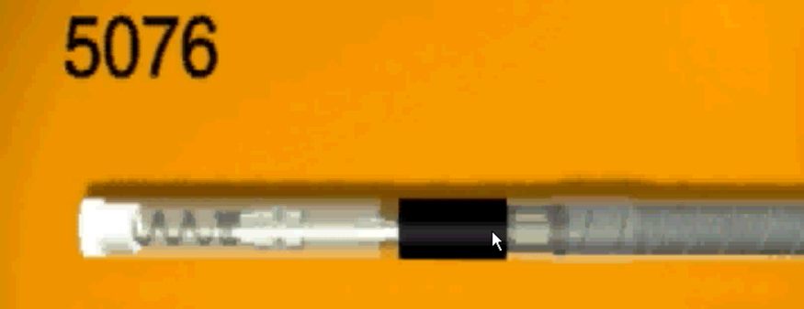
Transvenous Leads
Passive fixation (tined)
  The tines become lodged in the trabeculae of the apex or the pectinate of the appendage which are fibrous meshworks of heart tissue
Active fixation (screw-in)
  The helix, or screw, extends into the endocardial tissue
    Allows for lead positioning anywhere in the heart’s chamber
    The helix is extended using an included tool

Slide 12
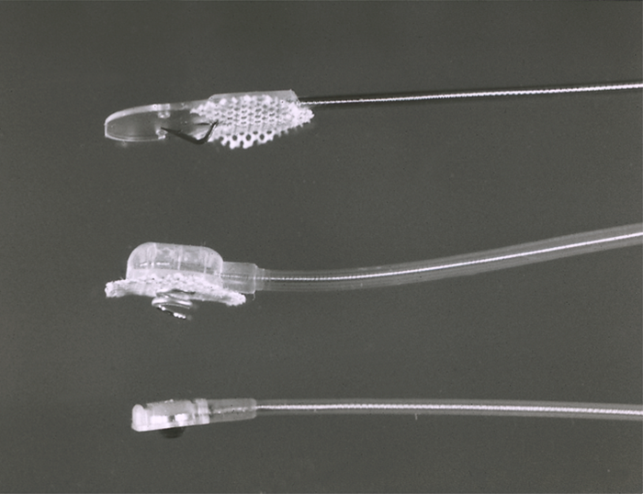
Epicardial Leads
Leads applied directly to the surface of the heart
  Utilized in pediatric patients and patients contraindicated for transvenous leads
  Fixation mechanisms include:
    Epicardial stab-in
    Myocardial screw-in
    Suture-on
  Applied via sternotomy, thoroscopy, or limited thoracotomy
Notes:
Epicardial or myocardial leads are implanted to the outside of the heart. These implants represent less than 5% of leads implanted, and are used primarily in pediatric cases, or for patients in whom transvenous lead implant is contraindicated.

Slide 13
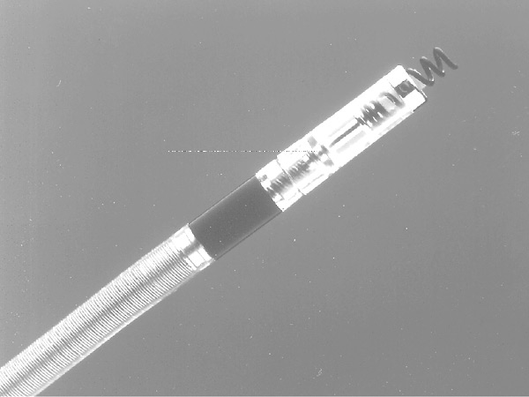
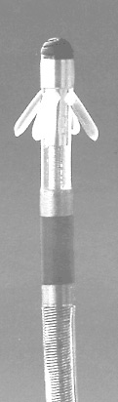
LEADS

Slide 14
Lead Insulation May Be Silicone or Polyurethane
Advantages of Silicone-Insulated Leads
Advantages of
Polyurethane-Insulated Leads
Inert
Biocompatible
Biostable
Repairable with medical adhesive
Historically very reliable
Biocompatible
High tear strength
Low friction coefficient
Smaller lead diameter

Slide 15
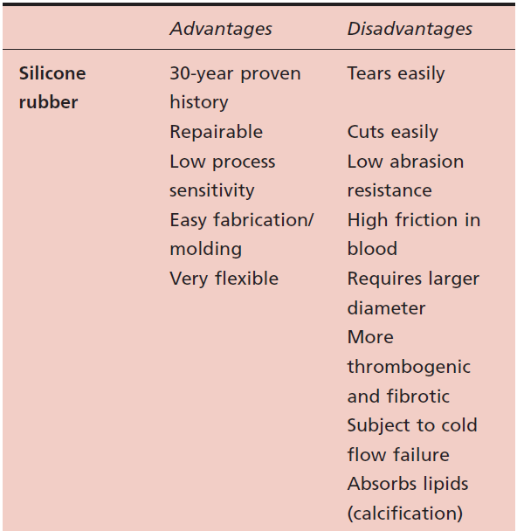
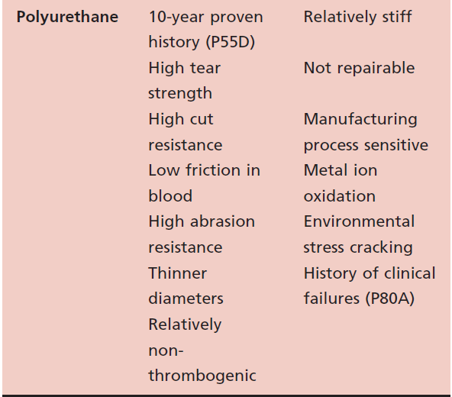

Slide 16
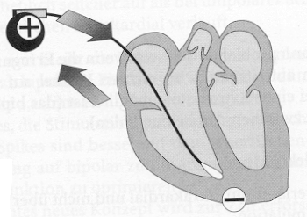
A Unipolar Pacing System
Flows through the tip electrode (cathode)
Stimulates the heart
Returns through body fluid and tissue to the IPG (anode)
Anode
-
Cathode

Slide 17
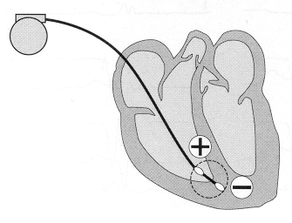
A Bipolar Pacing System
Flows through the tip electrode located at the end of the lead wire
Stimulates the heart
Returns to the ring electrode above the lead tip
Anode
Cathode
Tip electrode coil
Indifferent electrode
coil

Slide 18
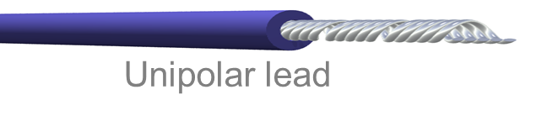
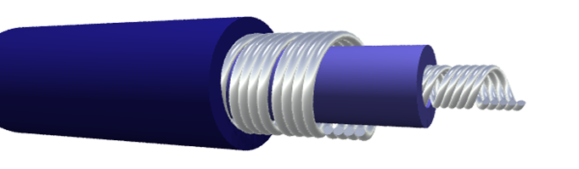
Lead Polarity
Unipolar leads
  May have a smaller diameter lead body than bipolar leads
  May exhibit larger pacing artifacts on the surface ECG
  May cause pectoral muscle stimulation
Bipolar leads
  Usually less susceptible to oversensing of non-cardiac signals (i.e., myopotentials, EMI, etc.)
Unipolar lead
To tip (cathode)
From ring (anode)
Bipolar coaxial lead

Slide 19
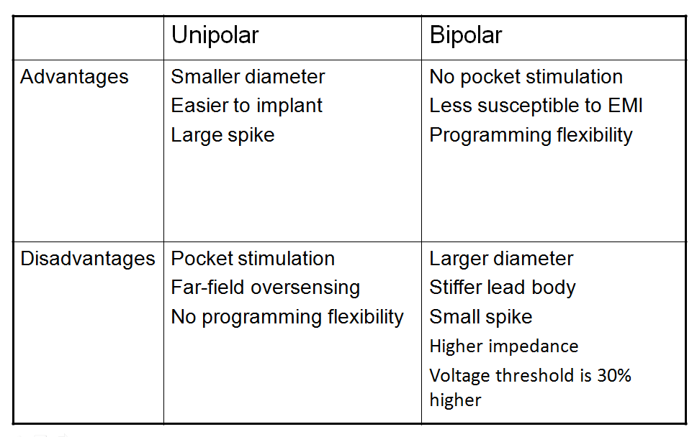

Slide 20
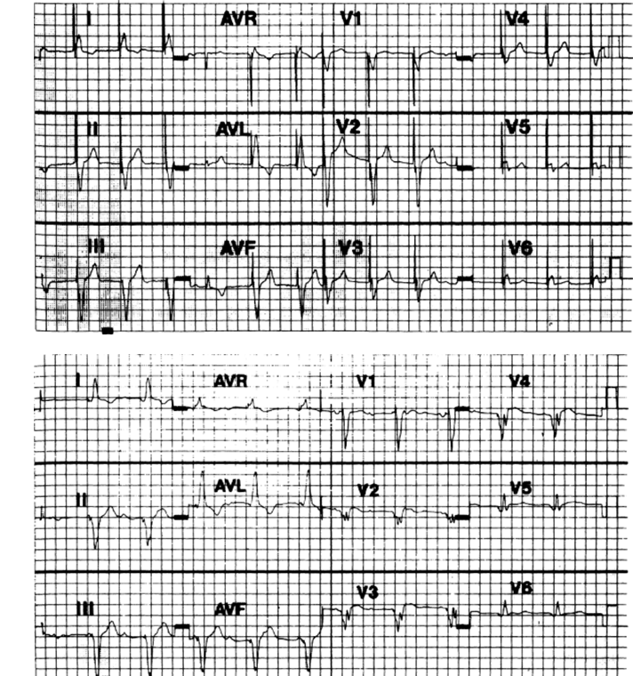

Slide 21
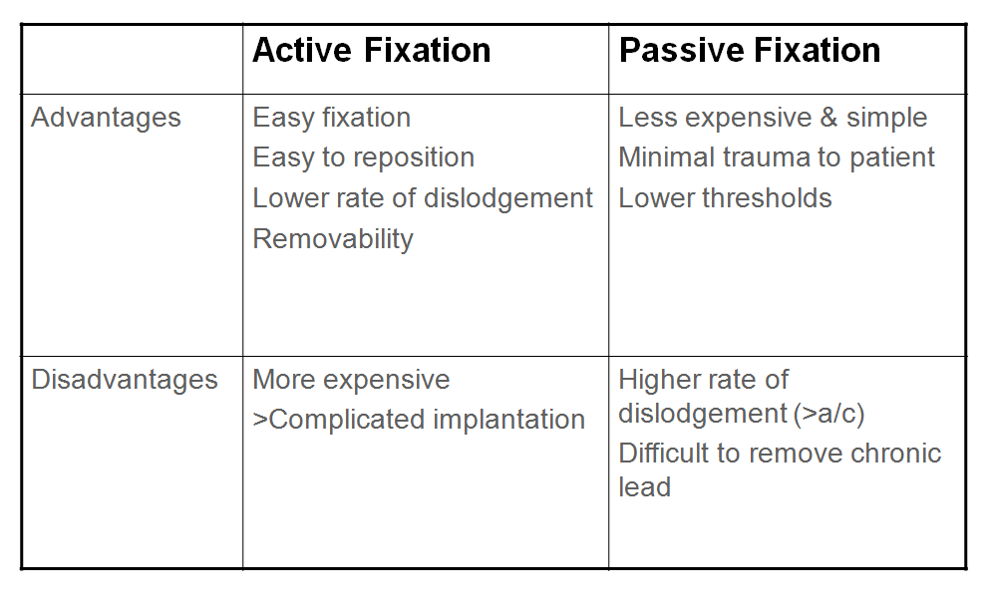

Slide 22
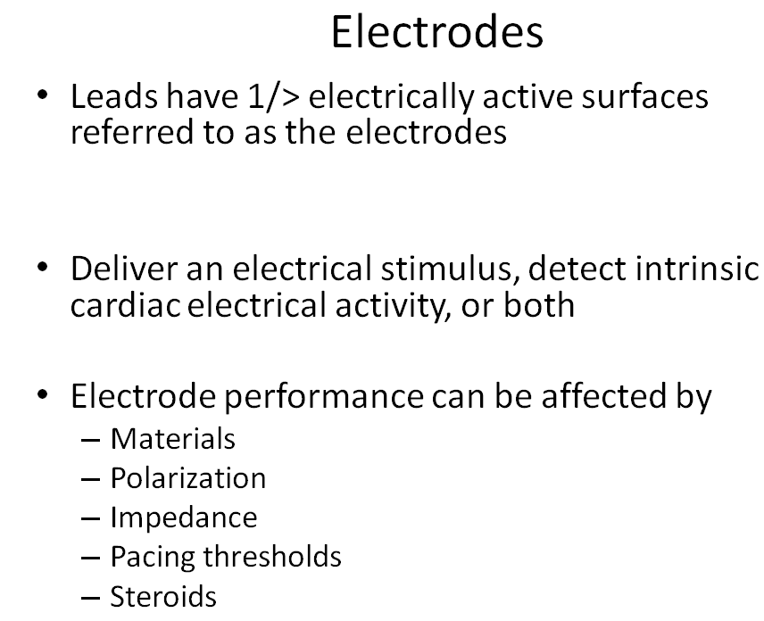

Slide 23
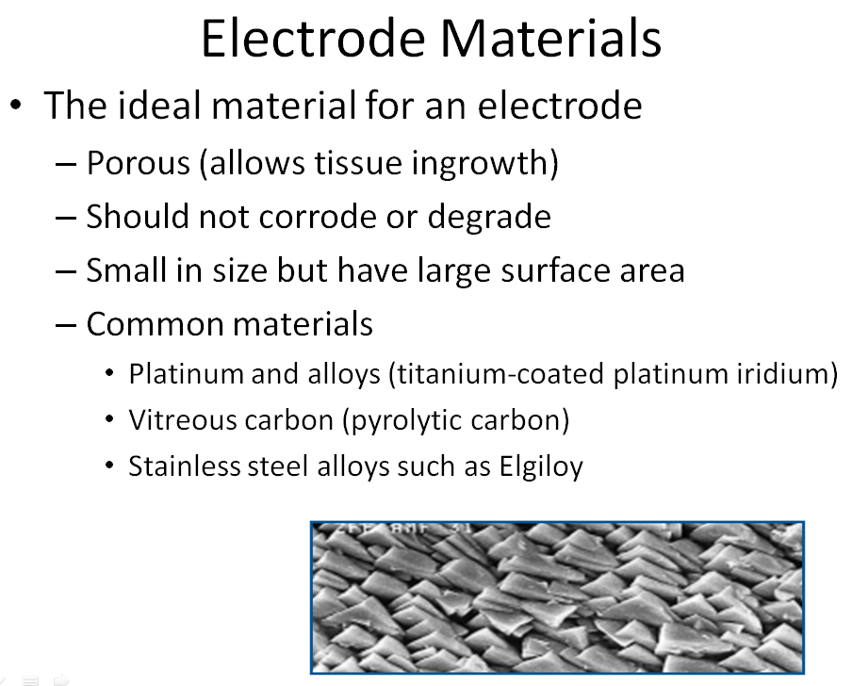

Slide 24
Characteristics of an electrical circuit:
Including a pacemaker circuit
Voltage
Current
Impedance
Notes:
Student Notes
Instructor Notes

Slide 25
Voltage
Voltage is the force, or “push,” that causes electrons to move through a circuit
In a pacing system, voltage is:
  Measured in volts (V)
  Represented by the letter “V”
  Provided by the pacemaker battery
  Often referred to as amplitude or pulse amplitude
Notes:
Student Notes
The terms “amplitude” and “voltage” are often used interchangeably in pacing, undoubtedly to express “Voltage Amplitude,” which refers to the voltage output.
Instructor Notes

Slide 26
Current
The flow of electrons in a completed circuit
In a pacing system, current is:
  Measured in milliamps (mA)
  Represented by the letter “I”
  Determined by the amount of electrons that move through a circuit
Notes:
Student Notes
Current: The movement of electricity, or free electrons, through a circuit. Current is measured in amperes and represented by the symbol I (capital I). One ampere is a unit of electrical current produced by 1 volt acting through a resistance of 1 ohm.
In pacing we express current as milliamps:
1 Ampere = 1000 milliamps
Instructor Notes

Slide 27
Impedance
The opposition to current flow
In a pacing system, impedance is:
  Measured in ohms (Ω)
  Represented by the letter “R”
  The measurement of the sum of all resistance to the flow of current
Notes:
Student Notes
Impedance is the sum of all resistance to the flow of current. The resistive factors to a pacing system include:
Lead conductor resistance
The resistance to current flow from the electrode to the myocardium
Polarization impedance, which is the accumulation of charges of opposite polarity in the myocardium at the electrode-tissue interface
Instructor Notes
Resistance is a term used to refer to simple electric circuits without capacitors, and with constant voltage and current. Impedance is a term used to describe more complex circuits with capacitors and with varying voltage and current. Therefore, the use of the term impedance is more appropriate than resistance when discussing pacing circuits, although both are used.

Slide 28
Voltage, Current, and Impedance are Interdependent
The interrelationship of the three components is analogous to the flow of water through a hose
  Voltage represents the force with which . . .
  Current (water) is delivered through . . .
  A hose, where each component represents the total impedance:
    The nozzle, representing the electrode
    The tubing, representing the lead wire
Notes:
Student Notes
In this analogy, voltage can be thought of as water pressure delivered by the system. Current is analogous to the amount of water delivered at the end of the hose, and resistance is the sum of all the forces opposing this flow of water. For example, the restriction at the nozzle, the friction along the hose and pipes, even the atmospheric pressure the water must flow through once it exits the hose.
Increasing the force of the water (opening the valve more, or somehow increasing the water pressure) will deliver more water to the hose, but it will also increase some of the resistance (for example, the friction within the hose and pipes).
Instructor Notes
Each of these three components in an electrical circuit are interdependent – this analogy may help you understand the relationship.

Slide 29
Voltage, Current, and Impedance
Voltage: The force moving the current (V)
  In pacemakers it is a function of the battery chemistry
Current: The actual continuing volume of flow of electricity (I)
  This flow of electrons causes the myocardial cells to depolarize (to “beat”)
Impedance: The sum of all resistance to current flow (R or Ω or sometimes Z)
  Impedance is a function of the characteristics of the conductor (wire), the electrode (tip), and the myocardium
Notes:
Student Notes
On this slide we have a review of the main terminology used to this point, and the symbols used to represent this concept in calculations, or perhaps in a medical record.
Instructor Notes

Slide 30
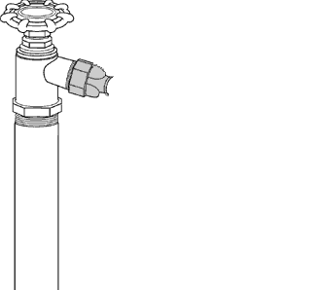
Voltage and Current Flow
Electrical Analogies
Spigot (voltage) turned up, lots of water flows (high current drain)
Water pressure in system is analogous to voltage – providing the force to move the current
Spigot (voltage) turned low, little flow
(low current drain)
Notes:
Student Notes
Using the garden hose as an analogy, the higher the voltage, the greater the push, or “flow” of electrons (and the greater the current drain).
Instructor Notes
This slide provides more information about the analogy on a mouse click. First ask the following question:
Ask: When the spigot is turned up, is there more or less water flow?
More—which is analogous to high current drain
Click your mouse to provide more information about the analogy.

Slide 31
Resistance and Current Flow
Electrical Analogies
Normal resistance – friction caused by the hose and nozzle
Low resistance – leaks in the hose reduce the resistance
More water discharges, but is all of it going to the nozzle?
High resistance – a knot results in low total current flow
Notes:
Student Notes
Resistance affects current flow. Leads with an insulation breach, such as the garden hose pictured in the middle, will measure a low resistance reading with a resultant high current drain, and possible premature battery depletion. Conversely, if there is a high resistance, such as a lead conductor break (represented by the knot), the current flow will be low or non-existent.
Instructor Notes
An analogy for the effect of resistance on current flow.

Slide 32
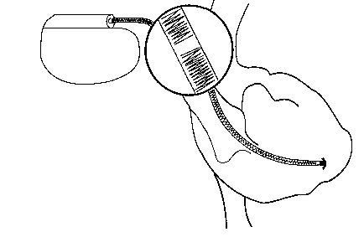
High Impedance Conditions
A Fractured Conductor
A fractured wire can cause Impedance values to rise
  Current flow from the battery may be too low to be effective
Impedance values may exceed 3,000 Ω
Lead wire fracture
Increased resistance
Other reason for high impedance: Lead not seated properly in pacemaker header (usually an acute problem).
Notes:
32
An example of a high impedance condition is when the conductor coil fractures with the insulation remaining intact.
Impedance may exceed 3,000 Ohms and the current flow may be too low to be effective.
If a complete fracture of the wire occurs:
No current will flow
Impedance number will be “infinite,” or 9999 Ohms
When suspecting a wire break, look for a trend of increasing impedance values, rather than a single lead impedance value. The multifilar construction of the leads sometimes means that some of the small conductor filaments fail, while others remain intact. You’ll typically see a trend if increasing impedances over time.

Slide 33
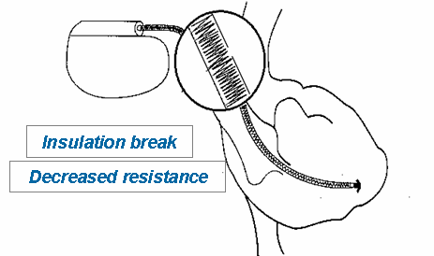
Low Impedance Conditions
An Insulation Break
Insulation breaks can cause impedance values to fall
  Current drain is high and can lead to more rapid battery depletion
  Current can drain through the insulation break into the body or other lead wire, not through myocardium
Impedance values may be less than 300 Ω
Notes:
33
Insulation around the lead wire prevents current loss from the lead wire. Electrical current seeks the path of least resistance, which is normally the conductor coil. Insulation breaks are often marked by a trend of falling impedance values. An impedance reading that changes suddenly, or one that is >30% lower than previously recorded values for a given patient, is considered significant and should be watched closely.
Insulation break that exposes a conductor causes the following
Impedance values to fall
Current to drain through the insulation break into the body, or into the other wire
Potential for loss of capture
More rapid battery depletion

Slide 34






Ohm’s Law
Describes the relationship between voltage, current, and resistance
V = I X R
I = V / R
R = V / I
V
=
I
X
R
V
V
I
=
R
I
R
V
I
=
R
Notes:
Student Notes
If any two values are known, the third may be calculated (cover the value you are seeking and the others appear in the appropriate format to calculate the unknown value).
Instructor Notes

Slide 35
Ohm’s law tells us:
If the impedance remains constant, and the voltage decreases, the current decreases
If the voltage is constant, and the impedance decreases, the current increases
Notes:
Student Notes
Ohm’s Law provides the rationale for many of the decisions we will make when evaluating pacing systems and making programming decisions.
Instructor Notes
Ask: So, what is the CLINICAL significance to all this information?
Proper management of electrical characteristics is important for patient safety and device longevity

Slide 36
Status Check
What happens to current if the voltage is reduced but the impedance is unchanged?
Start with:
  Voltage = 5 V
  Impedance = 500 Ω
  Current = 10 mA
Solve for Current (I):
  I = V/R
  I = 5 V ÷ 500 Ω = 0.010 Amps
  Current is 10 mA
Reduce the voltage to 2.5 V
  Voltage = 5 V
  Impedance = 500 Ω
  Current = ?
Is the current increased/ decreased or unchanged?
  I = V/R
  V = 2.5 V ÷ 500 Ω =
  0.005 Amps or 5 mA
The current is reduced
Notes:
Student Notes
If: Voltage = 2.5 V
Impedance = 500 ohms
1 Ampere = 1000 milliamps
Then use the formula I = V ÷ R to find I (the current).
The amount of current that flows through a pacemaker system is very small:
Use milliamps as a unit of measurement rather than amps. Convert amps to milliamps by multiplying amps by 1000 (or move the decimal three places to the right).
Instructor Notes
The clinical significance of reducing the current:
Ask: What affect will this have on the longevity of the pacemaker battery?
It will increase device longevity by reducing the drain on the battery
Ask: Will the pacing output still reliably capture the myocardium?
The less current the less likely you are to reliably capture the myocardium

Slide 37
Status Check
What happens to current if the impedance is reduced but the voltage is unchanged?
Start with:
  Voltage = 5 V
  Impedance = 500 Ω
  Current = 10 mA
Solve for Current (I):
  I = V/R
  I = 5 V ÷ 500 Ω = 0.010 Amps
  Current is 10 mA
Reduce impedance to 250 Ω
  Voltage = 5 V
  Impedance = 250 Ω
  Current = ?
Is the current increased/ decreased or unchanged?
  I = V/R
  V = 2.5 V ÷ 250 Ω =
  0.02 Amps or 20 mA
The current is increased
Notes:
Student Notes
If: Voltage = 5 V
Impedance = 250 ohms
1 Ampere = 1000 milliamps
Then use the formula I = V ÷ R to find I (the current).
The amount of current that flows through a pacemaker system is very small:
Use milliamps as a unit of measurement rather than amp. Convert amps to milliamps by multiplying amps by 1000 (or move the decimal three places to the right).
Instructor Notes
The clinical significance of increasing the current:
Ask: What effect will this have on device longevity?
It will increase battery drain and decrease device longevity.
Ask: Will the pacemaker reliably capture the myocardium?
The higher the current the more likely it is to capture the myocardium.
Ask: Could the patient notice any ill effects from increasing the current?
Yes, other muscles in the area of the pacing leads could be stimulated as well, for example the diaphragm.

Slide 38
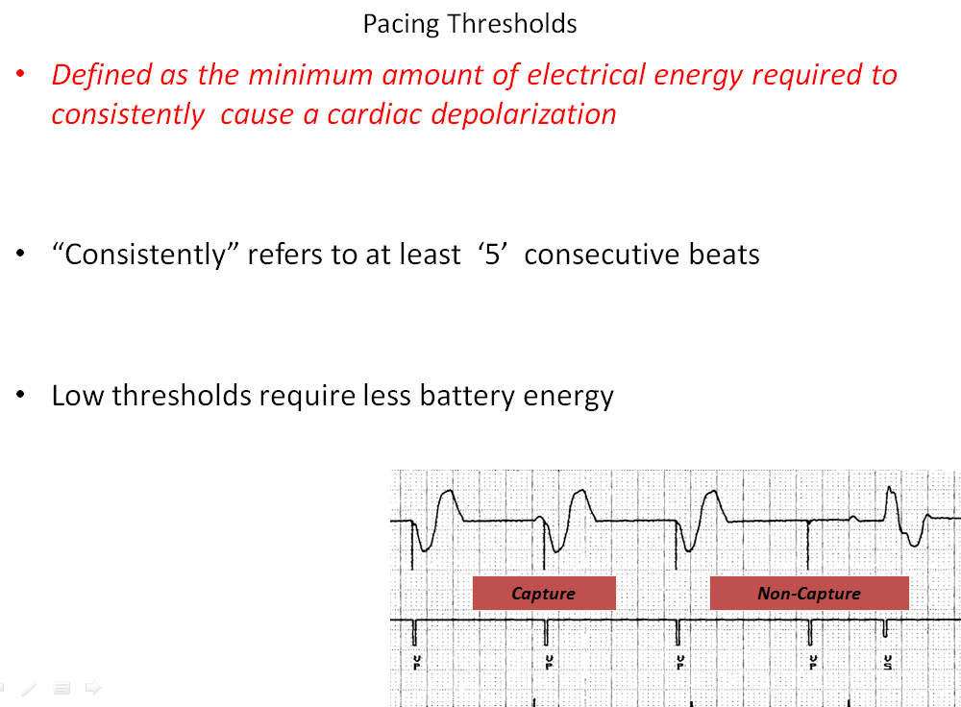

Slide 39
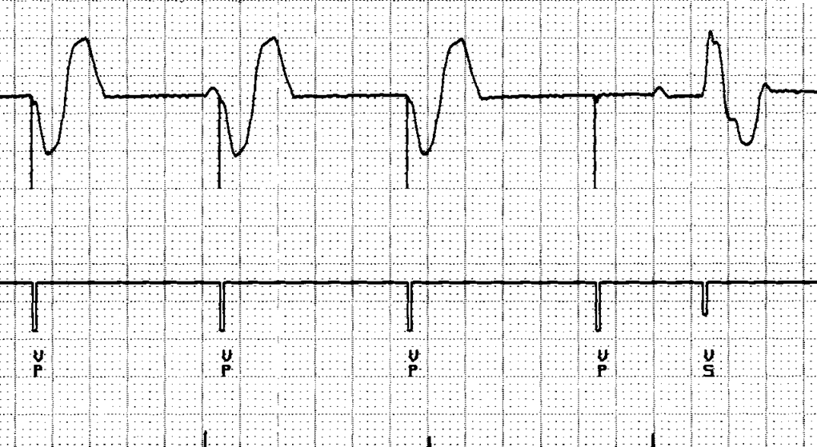
Capture Threshold
The minimum electrical stimulus needed to consistently capture the heart outside of the heart’s own refractory period
Ventricular pacemaker 60 ppm
Notes:
Capture threshold is defined as the minimum electrical stimulus required to CONSISTENTLY capture the heart outside of the myocardial refractory period (i.e., outside of the absolute and effective refractory periods). In this example of simple ventricular pacing, we see the first 3 pacing “spikes” are followed by QRS complexes, but the fourth is not. This fourth complex is an example of non-capture.

Slide 40
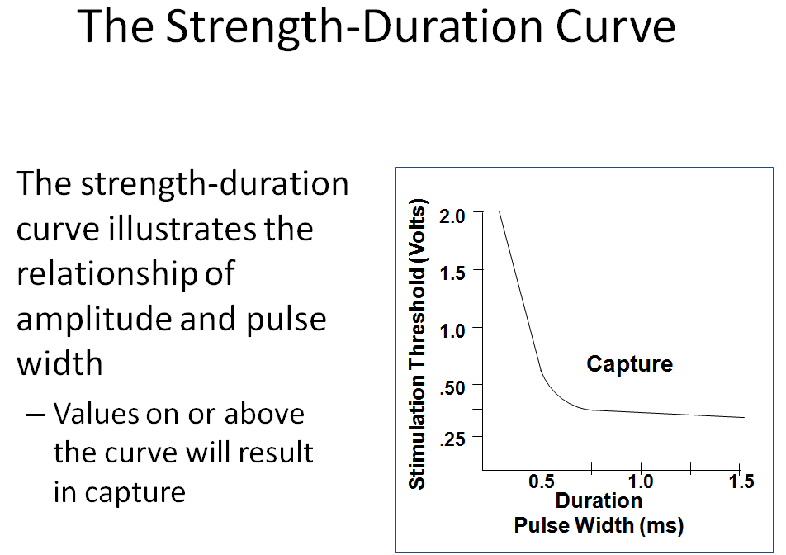

Slide 41
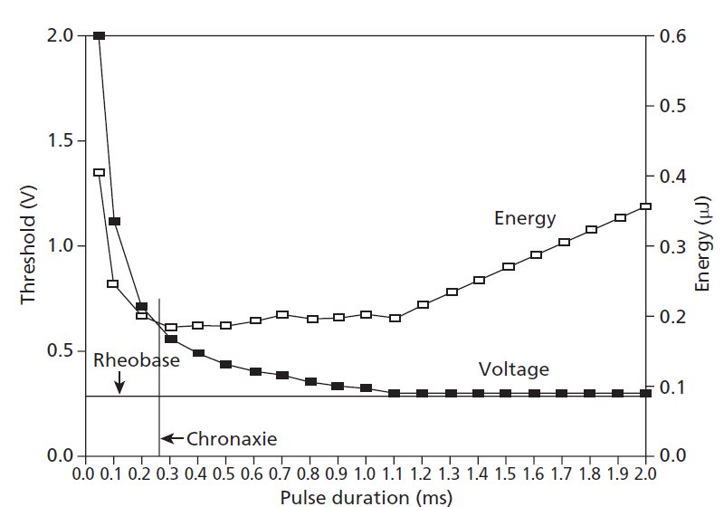

Slide 42
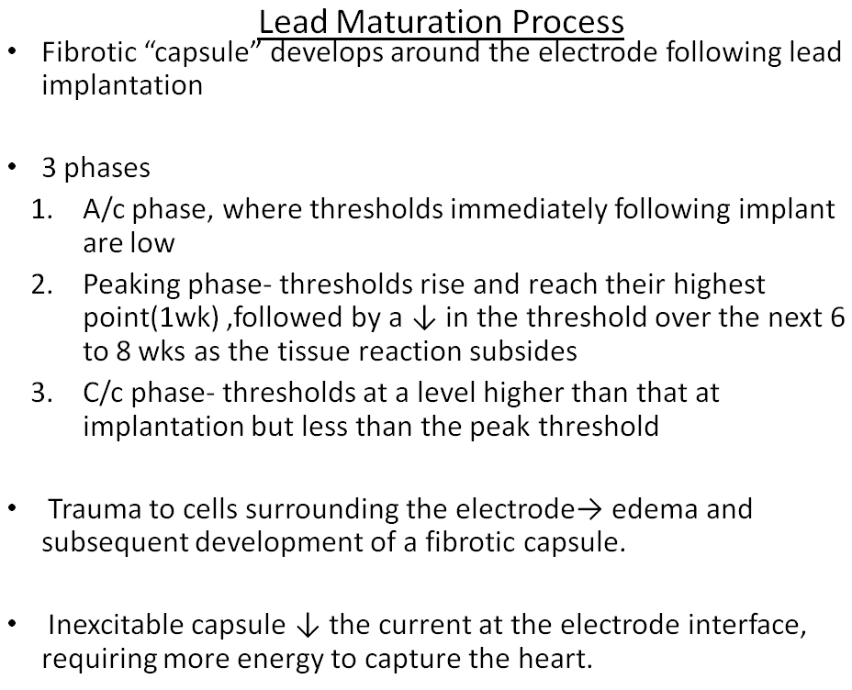

Slide 43
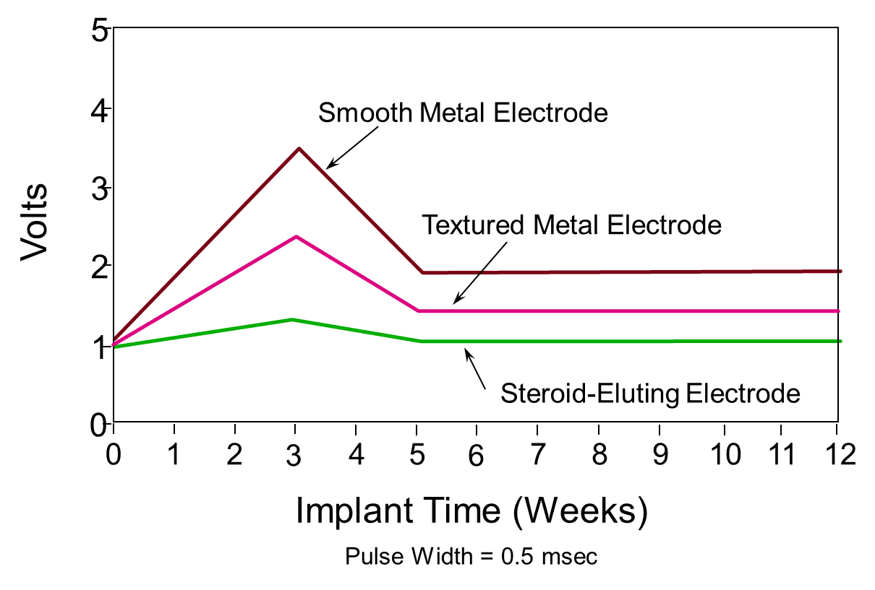
Effect of steroid on stimulation thresholds
Notes:
This graph compares the stimulation thresholds of contemporary pacing leads. Older, non-steroid electrodes exhibited higher threshold peaking than that of steroid leads shown on the slide.
The different types of electrodes exhibit a wide range of threshold peaking.
Steroid-eluting electrodes continue to show lower chronic stimulation thresholds and no significant peaking.
Threshold changes are shown here over a 12-week period post-implant, where a comparison is made between:
• Smooth metal electrode
• Textured metal electrode
• Steroid-eluting electrode
Traditionally, implant stimulation thresholds are relatively low. Non-steroid-eluting electrodes exhibit a peaking phase from week 1 to approximately week 6, due to the maturation process at the electrode-tissue interface. Steroid-eluting electrodes exhibit virtually no peaking.
The chronic phase of stimulation threshold occurs 8-12 weeks post-implant, which is characterized by a plateau. This plateau is higher than the acute phase, due to fibrotic encapsulation of the electrode. Steroid-eluting lead chronic thresholds remain close to implant values.
References: Pacing Reference Guide, Bakken Education Center, 1995, UC199601047aEN. Cardiac Pacing, Second Edition, Edited by Kenneth A. Ellenbogen. 1996.

Slide 44
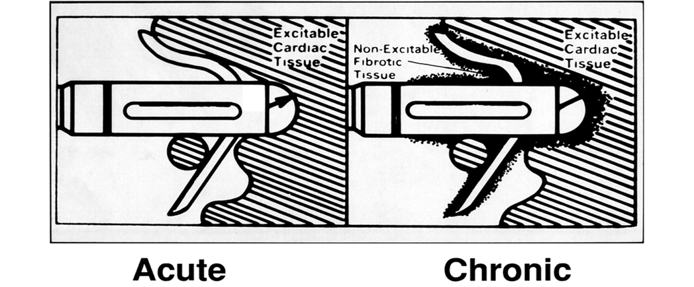
Effect of Lead Design on Capture
Lead maturation
  Fibrotic “capsule” develops around the electrode following lead implantation
  May gradually raise threshold
  Usually no measurable effect on impedance
Notes:
Once a pacemaker and its leads are implanted into the body, a maturation process begins. For the leads, there are three phases that make up this process:
The acute phase, where thresholds immediately following implant are low
The peaking phase, where thresholds rise and reach their highest point, usually around one week post-implant. This is followed by a decline in the threshold over the next 6 to 8 weeks as the tissue reaction subsides.
The chronic phase, where thresholds assume a stable reading to a level somewhat higher than that at implantation, but less than the peak threshold
The lead maturation process occurs due to the trauma to cells surrounding the electrode, which causes edema, and subsequent development of a fibrotic capsule. The unexcitable capsule reduces the current at the electrode interface, requiring more energy to capture the heart.

Slide 45
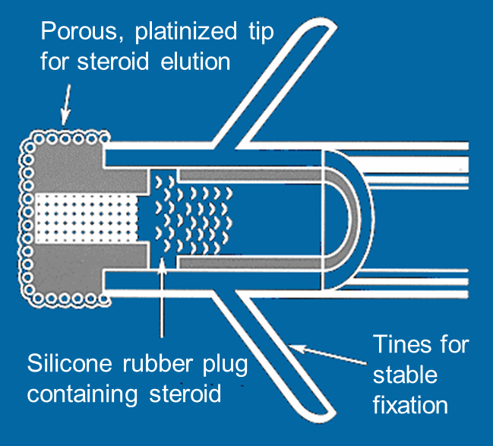
Steroid Eluting Leads
Steroid eluting leads reduce the inflammatory process
  Exhibit little to no acute stimulation threshold peaking
  Leads maintain low chronic thresholds
Notes:
Steroid eluting leads reduce inflammation by employing a capsule of dexamethasone sodium phosphate This steroid is gradually emitted over time, nearly eliminating the peaking phenomenon of the lead maturation process, and greatly reducing the formation of the fibrotic capsule around the cathode.
Medtronic first introduced steroid eluting leads in the mid 1980’s. Today we manufacture and sell steroid eluting leads with active and passive fixation, and even epicardial steroid eluting leads.

Slide 46
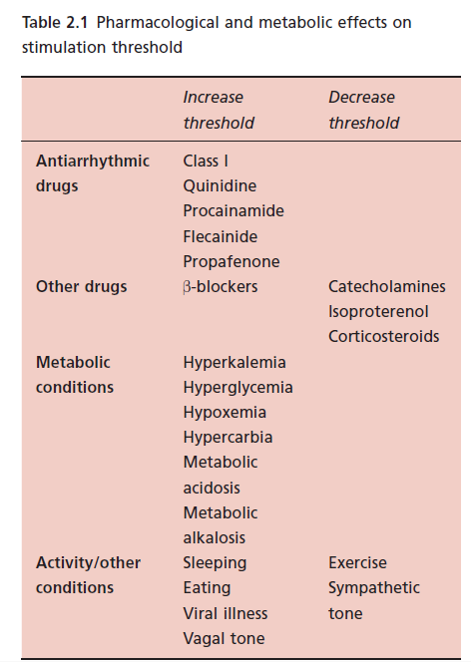

Slide 47
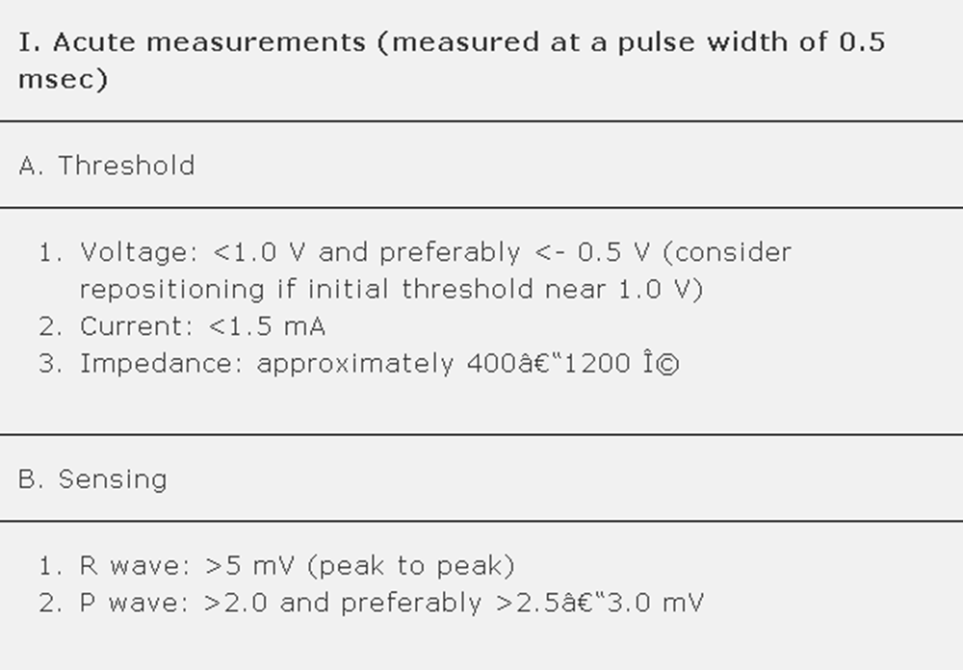

Slide 48
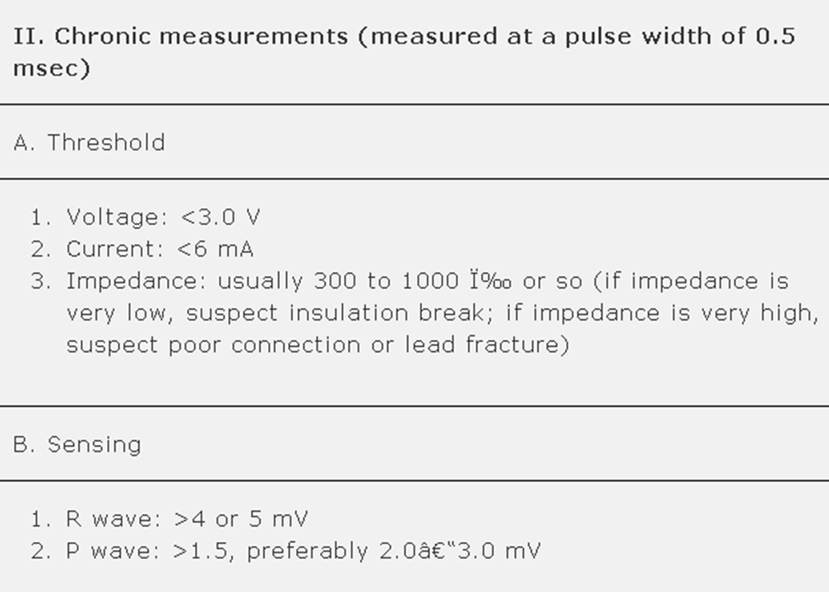

Slide 49
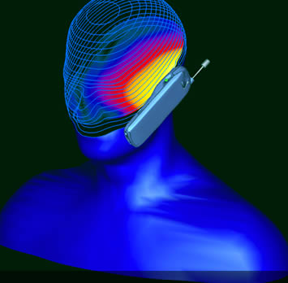
Electromagnetic Interference
Can interfere with function of pacemaker or ICD
Device misinterprets the EMI causing
  Rate alteration
  Sensing abnormalities
  Asynchronous pacing
  Noise reversion
  Reprogramming

Slide 50
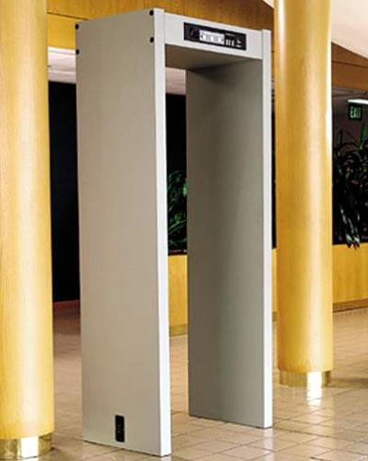
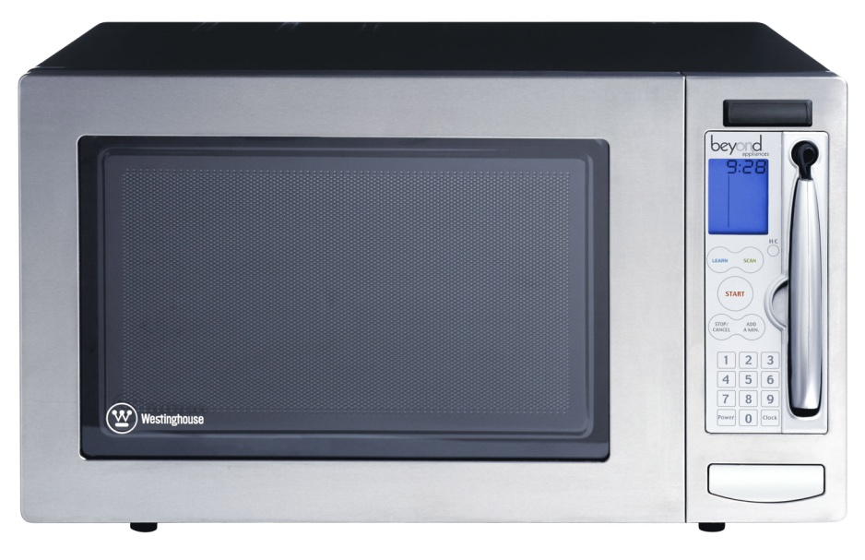
Electromagnetic Interference
Examples
  Metal detectors
  Cell phones
  High voltage power lines
  Some home appliances (microwave)

Slide 51
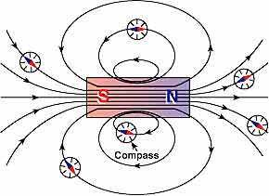
Electromagnetic Interference
Intensity of electromagnetic field decreases inversely with the square of the distance from the source
Newer pacemakers and ICDs are being built with increased internal shielding

Slide 52
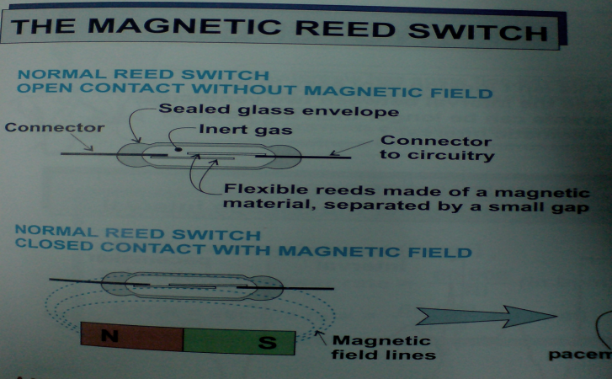
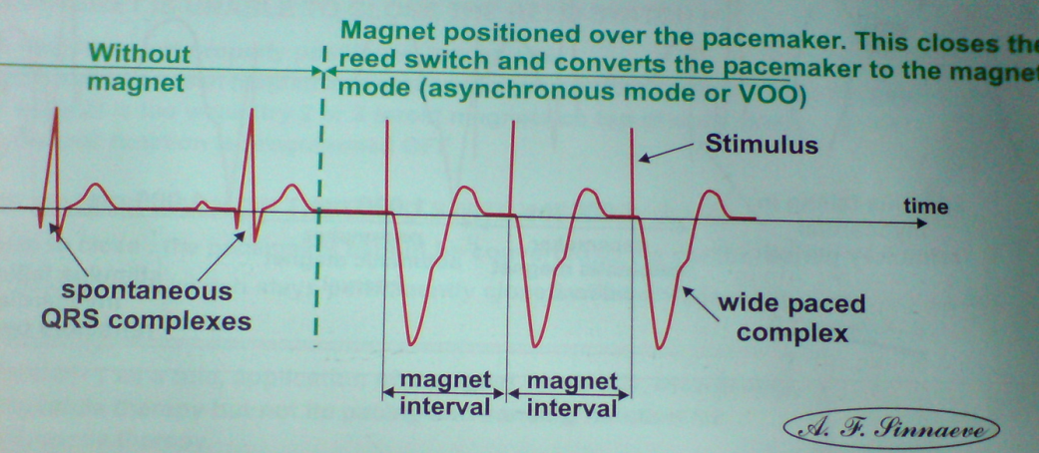
Magnet mode
Activates magnetic reed switch
Model dependent behavior with magnet
  Asynchronous pacing – most common
  No apparent rate or rhythm change
  Brief asynchronous pacing and then return to programmed value
  Continuous or transient loss of pacing
Magnets will cause most DDDs to convert to DOO at about 85 with a BOL (beginning of life) battery, and to VOO at a rate of about 65 at ERI (effective replacement interval) is reached to conserve power.

Slide 53
Pacemaker Company |  | Magnet Mode Designation | Explanation
Biotronik (except INOS and DROMOS) |  | AUTO | If battery okay, 10 asynchronous events at 90 beats/min, then returns to original programmed mode, without rate responsiveness. Pacing is at the lowest available rate (LRL, sleep rate, or hysteresis rate). If battery at ERI, 10 asynchronous events at 80 beats/min in the VOO mode, then either VDD (dual-chamber) or VVI (single-chamber) pacing at 11% lower than the lowest available rate. For any dual-chamber mode (DDD, DDI, or VDD), the AV delay shortens to 100 msec while the magnet is in place
 |  | ASYNCH | Asynchronous pacing at 90 beats/min if battery okay. At ERI, 80 beats/min (single-step change) in the VOO mode regardless of original programming. For any dual-chamber mode (DDD, DDI, or VDD), the AV delay shortens to 100 msec while the magnet is in place
 |  | SYNCH | If battery okay, pacing in original programmed mode, without rate responsiveness. Pacing is at the lowest available rate (LRL, sleep rate, or hysteresis rate). If battery at ERI, either VDD (dual-chamber) or VVI (single-chamber) pacing at 11% lower than the lowest available rate. For any dual-chamber mode (DDD, DDI, or VDD), the AV delay shortens to 100 msec while the magnet is in place
Boston Scientific/Guidant Medical/CPI |  | ASYNCH | Asynchronous pacing at 100 beats/min if okay, 85 beats/min at ERI (single-step change). The Insignia model has an intermediate step at 90 beats/min at IFI. For Triumph and Prelude models, see Medtronic pacemakers, below
 |  | OFF | No change, magnet is ignored. OFF is the magnet mode after a “power on reset,” which can occur secondary to EMI
 |  | EGM mode | No change in pacing. Magnet application initiates data collection
Medtronic |  |  | Asynchronous pacing at 85 beats/min if okay, SSI at 65 beats/min regardless of original programming if ERI detected (single-step change). Most Medtronic pacemakers emit one or more ventricular pulses during the first 3-7 asynchronous events (which might be at a rate of 100 beats/min) at a reduced pulse width or voltage to demonstrate the adequacy of ventricular pacing output. Also, Medtronic pacemakers default to SSI pacing at 65 beats/min, without rate responsiveness, on detection of ERI, regardless of whether a magnet is present
St. Jude Medical (not including Telectronics) | “SJM” x-ray logo | Battery Test | Asynchronous pacing at 98.6 beats/min gradually decreasing to <86.3 beats/min at ERI
 |  | OFF | No magnet response
 |  | Event snapshots | No change in pacing. Magnet application causes pacemaker to collect data. Identity and Entity models lack this feature
 |  | Event snapshots + Battery Test | For a magnet placed 2 seconds, pacing mode and rate are unchanged and the device stores an EGM. If the magnet is placed ≥5 seconds, the Battery Test mode (see above) is activated. Identity and Entity models lack this feature
 | Pacesetter x-ray logo (ψ) | Battery Test | Asynchronous pacing, with rate depending on the specific model. In general, a pacing rate of less than 90 beats/min should prompt further evaluation
 |  | OFF | No magnet response
 |  | VARIO mode (present in some models) | VARIO results in a series of 32 asynchronous pacing events. The rate of the first 16 paces reflects battery voltage, which gradually declines from 100 to 85 beats/min at ERI. The next 15 paces are used to document the ventricular pacing capture safety margin. The rate will be 119 beats/min with gradually declining pacing voltage. The 16th pace of this group is at no output. The next pace restarts the 32-event sequence. The 32-event sequence repeats as long as the magnet remains in place
Notes:
The effect or effects of appropriately placing a magnet over a pacemaker are shown. Column 1 shows the pacemaker manufacturer. If the magnet response is programmable, column 2 shows the various programmable modes available. The first mode shown for a company is the default mode. Column 3 shows the effect on pacing therapy for the magnet mode shown in column 2. Unless otherwise specified, asynchronous pacing takes place, without rate responsiveness, in the chambers originally programmed. Thus, a dual-chamber program would result in DOO pacing, and a single-chamber program would result in VOO pacing (unless an atrial device is used, which would be AOO), and a biventricular, dual-chamber device would be DOOOV.

Slide 54
Activity Sensors
Activity sensors employ a piezoelectric crystal that detects mechanical signals produced by movement
The crystal translates the mechanical signals into electrical signals that in turn increase the rate of the pacemaker
Piezoelectric crystal

Slide 55
Rate-adaptive/rate-modulated pacing
normal heart rate response to increased physiological demand is linearly related to oxygen demand/consumption
greater proportion of rate-adaptive sensors belong to a secondary class of sensors that detect physiological changes as a consequence of exercise such as:
  such as QT interval shortening
  increase in respiratory or minute-ventilation rate
  increased mean atrial rate
  rise in central venous temperature
  decrease in venous blood pH
  increase in right ventricular stroke volume
  increase in ventricular inotropy (e.g. peak endocardial acceleration and ventricular impedence variation).

Slide 56
Rate Responsive Pacemakers
Rate-Responsive Pacing
Fixed-Rate Pacing
Normal Heart Rate
Running
150
Walking
100
Heart Rate (bpm)
Wake-up
Sleeping
Sitting
Resting
50
0
Daily Activities

Slide 57
Stimulation Threshold
Pacing Voltage Threshold
  The minimum pacing voltage
  at any given pulse width
  required to consistently stimulate the heart
  outside the myocardial refractory period causing it to contract

Slide 58
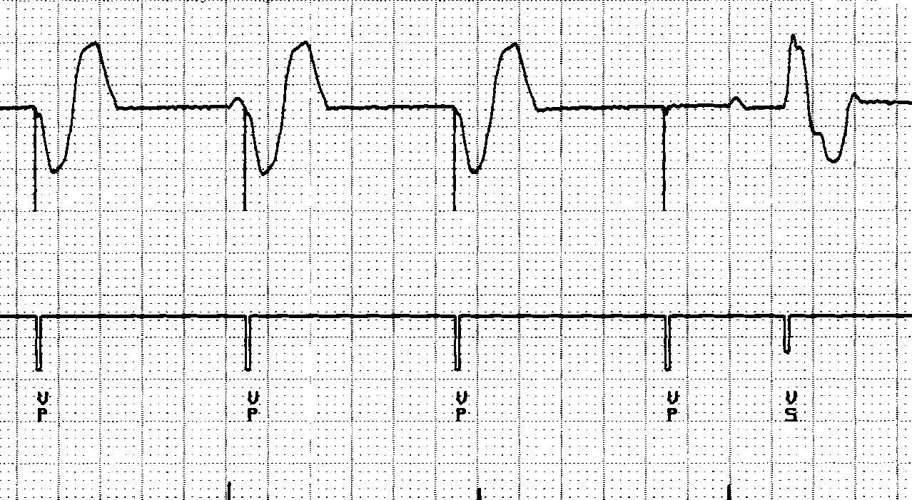
Capture – Loss of Capture
Capture
Non-Capture
VVI / 60
Notes:
Speakers Notes
What to say:
What to Do:
What to Ask:
Optional Information:
Optional Resources:
References:
Speakers Notes
What to say:
What to Do:
What to Ask:
Optional Information:
Optional Resources:
References:

Slide 59
The Voltage-Strength Duration Curve
Stimulus Voltage & Pulse Width have an exponential relationship
At short pulse widths (<0.25 ms) the curve rises sharply
At long pulse widths (>1.0 ms) the curve is flat
2.0
1.5
1.0
Stimulation Threshold (Volts)
Capture
.50
.25
0.25
1.0
1.5
Duration
Pulse Width (ms)

Slide 60
The Pacing Pulse
V = Pulse Amplitude in Volts (V) (say 2.5 V)
t = Pulse Duration or Width in milliseconds (ms)
(say 0.5 ms)
R = Impedance of Pacing Circuit (ohms)
(say 500 ohms)
I = V/R = Current through pacing circuit (mA)
= 2.5 V/ 500 ohms = 0.005 A = 5 mA
E = Energy delivered by Pulse to the Pacing Circuit
and Cardiac Tissue
= V . I . t = I²Rt = V²t/R
= 2.5 V . 5 mA . 0.5 ms = 6.25 micro Joules
If V = 5 V Energy = 25 micro Joules
t
Pacing Pulse
V
Output Voltage
t
Pulse Duration (Width)

Slide 61
Why measure stimulation threshold?
To enable programming stimulus voltage amplitude and pulse width such that
  Consistent capture & Patient Safety is ensured
  Battery drain minimized, Pacemaker longevity maximized
  Good thresholds
    Ventricle - <1V @ 0.5ms
    Atrium - <1.5V @ 0.5ms

Slide 62
Evolution of Pacing Threshold
6
s
Safety Margin
4
Voltage
Threshold (V)
3
2
Chronic Phase
1
Acute Phase
0
4
8
12
16
Observation Time (weeks)

Slide 63
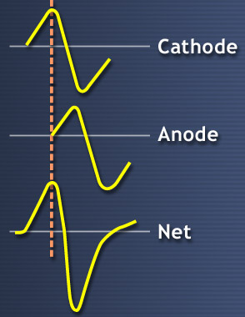
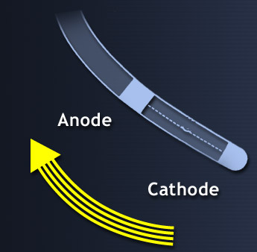
Sensing of intrinsic heartbeats
Sensing is the ability of the pacemaker to “see” when an intrinsic depolarization is occurring
  Pacemakers record the Intracardiac Electrogram (EGM) by constantly recording the potential difference between the cathode and anode
Processed by Device
Depolarization Wave

Slide 64
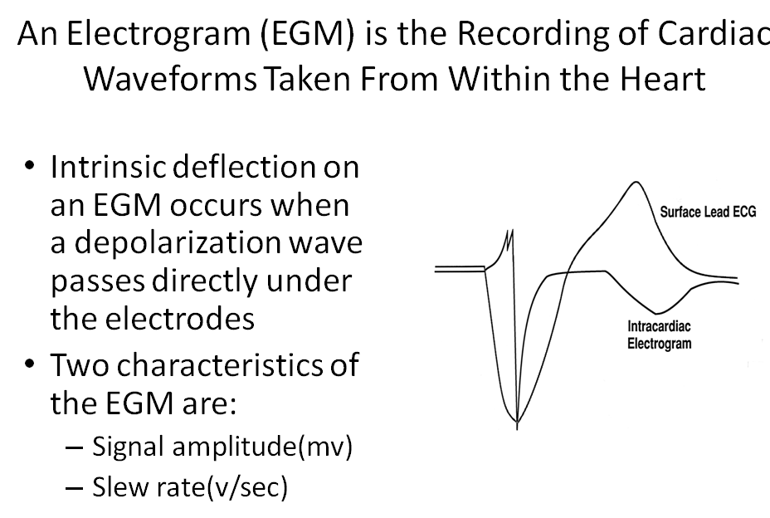

Slide 65
Intrinsic R wave Amplitude
Intrinsic R wave amplitude 5 mV
Intrinsic P wave amplitude 2 mV
Intrinsic R wave in EGM
Amplitude
The Intrinsic R wave amplitude is usually much greater than the T wave amplitude

Slide 66


Slide 67


Slide 68


Slide 69


Slide 70
Sensitivity Setting
5.0
5.0
2.5
2.5
Amplitude (mV)
Amplitude (mV)
1.25
1.25
Time
Time
Sensitivity settings less than 2.5 mv – High sensitivity – can lead to oversensing
Sensitivity settings greater than 2.5 mV – Low sensitivity – can lead to undersensing

Slide 71

Undersensing . . .
Pacemaker does not “see” the intrinsic beat, and therefore does not respond appropriately
Scheduled pace delivered
Intrinsic beat not sensed
VVI / 60
Notes:
Speakers Notes
What to say:
What to Do:
What to Ask:
Optional Information:
Optional Resources:
References:
Speakers Notes
What to say:
What to Do:
What to Ask:
Optional Information:
Optional Resources:
References:

Slide 72

Oversensing
Marker channel shows intrinsic activity...
...though no activity is present
An electrical signal other than the intended P or R wave is detected
Pacing is inhibited
Notes:
Speakers Notes
What to say:
Oversensing will exhibit pauses in single chamber systems. In dual chamber systems, atrial oversensing may cause fast ventricular pacing without P waves preceding the paced ventricular events.
What to Do:
What to Ask:
Optional Information:
Optional Resources:
References:

Slide 73


Slide 74


Slide 75
Values to remember
Pacing Thresholds
  Atrium - <1.5V; Ventricle <1V @ 0.5ms PW
Outputs
  2 X threshold Voltage
  Doubling Voltage output = 4 X Energy drain from battery
P / R wave amplitudes
  P Wave > 2mV
  R Wave > 5mV
Sensitivity
  R / P wave > 2 X Sensitivity setting
  Oversensing – Increase sensitivity ( Reduce value)
  Undersensing – Reduce sensitivity ( Increase value)
Lead impedance
  300 – 1200 ohms – Normal
  > 3000 Ohms - lead fracture / Loose set screw / inadequate lead pin insertion
  < 300 Ohms – Insulation break
  If impedance is out of range – try unipolar configuration

Slide 76
NBG Code – The Usual Pacing Modes
Chamber(s) Paced | Chamber(s) Sensed | Response to Sensing | Rate Modulation | Multisite Pacing
O = None A = Atrium V = Ventricle D = Dual (A +V) + V) S = Single (A or V) | O = None A = Atrium V = Ventricle D = Dual (A + V) S = Single (A or V) | O = None T = Triggered I = Inhibited D = Dual (T + I) | O = None R = Rate modulation | O = None A = Atrium V = Ventricle D = Dual (A + V)
Examples of pacing modes which are typically programmed:
  DDD VVI DDIR
  DDDR VVIR AAIR

Slide 77


Slide 78


Slide 79


Slide 80


Slide 81


Slide 82


Slide 83


Slide 84


Slide 85


Slide 86


Slide 87


Slide 88


Slide 89


Slide 90


Slide 91


Slide 92


Slide 93


Slide 94


Slide 95


Slide 96


Slide 97


Slide 98


